Slide 1


CE251 : JAVA PROGRAMMING
July – December 2020
Java Multithreading
Prof. Mohammed Bohra
Assistant Professor

Slide 2


What are Multithreading Applications?

Slide 3
What is Multithreading?
A multithreading program contains two or more parts that can run concurrently, Each part of such a program is called a thread, and each thread defines a separate path of execution.
A multithreading is a specialized form of multitasking.
Means execute more then one task at a time called multitasking

Slide 4
Difference b/w Process & Thread
A process consists of the memory space allocated by the operating system that can contain one or more thread.
A thread can’t exit on its own, it must be a part of process.
A process remains running until all of the non deamon threads are done executing.

Slide 5
So Multithreading
Execute more than one thread at a time.
Each & every thread is separate independent part of same application.

Slide 6
Life cycle of a Thread
A thread goes through various stage in its life cycle.
For example- a thread is born, started, runs & then dies
There are 5 stages in the life cycle of the thread
New
Runnable
Waiting
Timed waiting
Terminated

Slide 7
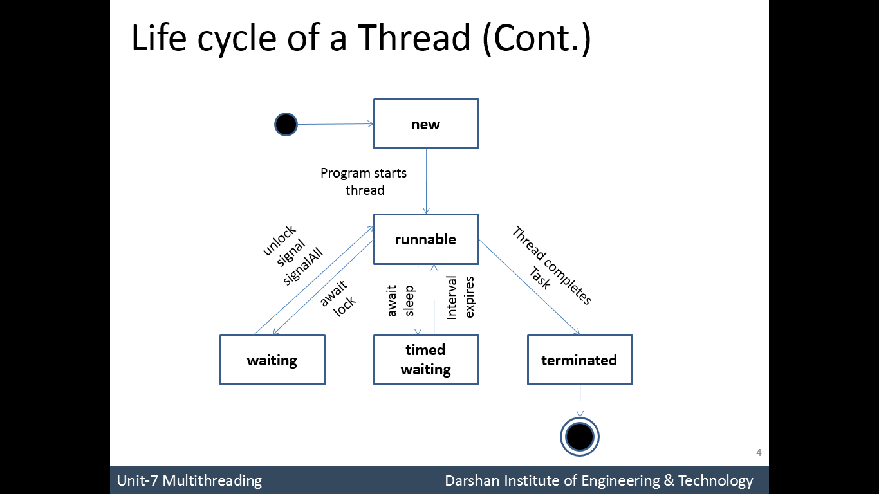

Slide 8
Creating a Thread in Java
There are two ways in which we can create a Thread in Java
Creating a Thread by extending the Thread class
Creating a Thread by implementing the Runnable interface
Thread class & Runnable interface present in java.lang package
We will look in to each of this method with example

Slide 9
1) By Extending Thread Class
Step-1 create a new class that extends Thread class
Step-2 extending class must override the run() method, which is the entry point for the new thread.
Step-3 create an instance of Thread class
Step-4 call start() method to begin execution of the new thread.

Slide 10
Example
class MyThread extends Thread{
public void run(){
}
}
MyThread t = new MyThread();
t.start();

Slide 11
Example
class ThreadDemo
{
public static void main(String[] args) {
MyThread t = new MyThread();
t.start();
for(int i=0; i<10; i++)
{
System.out.println(“main thread");
}
}
}
class MyThread extends Thread
{
public void run()
{
for(int i=0; i<10; i++)
{
System.out.println("user thread");
}
}
}

Slide 12
How many thread will be created?
2 thread
main thread created first
main thread will create another thread
Every thread have separate stack memory

Slide 13
t.start()
At this line, application contain two thread
main thread & user thread
Which thread will execute first?
Thread execution decided by Thread scheduler, one of the component of JVM

Slide 14
What happen during the execution?
Where the start() method define?
JVM will found start() method in Thread class
Thread class start() method perform two action
Thread is registered to thread scheduler then thread will be created
Thread class start() method automatically call run() method

Slide 15
Output
main thread
main thread
main thread
main thread
main thread
main thread
main thread
main thread
main thread
main thread
user thread
user thread
user thread
user thread
user thread
user thread
user thread
user thread
user thread
user thread

Slide 16
Example-2 create another thread
class ThreadDemo
{
public static void main(String[] args) {
MyThread t1 = new MyThread();
t1.start();
MyThread t2= new MyThread();
t2.start();
for(int i=0; i<4; i++)
{
System.out.println(“main thread");
}
}
}
class MyThread extends Thread
{
public void run()
{
for(int i=0; i<4; i++)
{
System.out.println("user thread");
}
}
}

Slide 17
How many thread will be created?
3 thread
main thread created first
main thread will create 2 more thread
Every thread have separate stack memory
This is the example that multiple thread performing single task

Slide 18
Output
user thread
user thread
user thread
user thread
main thread
main thread
main thread
main thread
user thread
user thread
user thread
user thread
main thread
main thread
main thread
main thread
user thread
user thread
user thread
user thread
user thread
user thread
user thread
user thread
OR

Slide 19
Example-3
class MyThread extends Thread
{
public void run()
{
for(int i=0; i<10; i++)
{
System.out.println("call No = "+i);
try{
sleep(1000);
}catch(InterruptedException e){
e.printStackTrace();
}
}}}
class ThreadDemo
{
public static void main(String[] args) {
MyThread t = new MyThread();
t.start();
for(int i=0; i<10; i++)
{
System.out.println(“main thread");
}
}
}

Slide 20
Output
call No = 0
main thread
main thread
main thread
main thread
call No = 1
call No = 2
call No = 3
call No = 4
call No = 5
call No = 6
call No = 7
call No = 8
call No = 9

Slide 21
Example-4
class ThreadDemo
{
public static void main(String[] args) {
MyThread t1 = new MyThread();
t1.start();
MyThread t2 = new MyThread();
t2.start();
for(int i=0; i<4; i++)
{
System.out.println(“main thread");
}
}
}
class MyThread extends Thread
{
public void run()
{
for(int i=0; i<5; i++)
{
System.out.println("call No = "+i);
try{
sleep(1000);
}catch(InterruptedException e){
e.printStackTrace();
}
}}}

Slide 22
Output
main thread
main thread
main thread
main thread
call No = 0
call No = 0
call No = 1
call No = 1
call No = 2
call No = 2
call No = 3
call No = 3
call No = 4
call No = 4
call No = 0
main thread
main thread
main thread
main thread
call No = 0
call No = 1
call No = 1
call No = 2
call No = 2
call No = 3
call No = 3
call No = 4
call No = 4
OR

Slide 23
Example- MyThread class without run() method
class ThreadDemo
{
public static void main(String[] args) {
MyThread t = new MyThread();
t.start();
for(int i=0; i<4; i++)
{
System.out.println(“main thread");
}
}
}
class MyThread extends Thread
{
}
Will it compile or not?

Slide 24
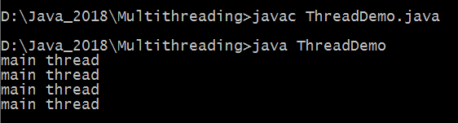
Output-
Thread class run() method will call with empty implementation- not recommended

Slide 25
Can we override the start() method?
class MyThread extends Thread
{
public void start()
{
for(int i=0; i<4; i++)
{
System.out.println("call No = "+i);
try{
sleep(1000);
}catch(InterruptedException e){
e.printStackTrace();
} }
}
}
class ThreadDemo
{
public static void main(String[] args) {
MyThread t1 = new MyThread();
t1.start();
MyThread t2 = new MyThread();
t2.start();
for(int i=0; i<4; i++)
{
System.out.println(“main thread");
}
}
}

Slide 26
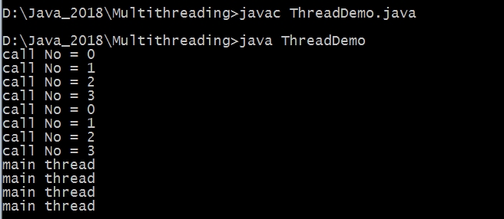
Output-
Overriding start() method but Thread will not created – means Thread class will not used

Slide 27
Can we overload run() method?
class MyThread extends Thread
{
public void run()
{
for(int i=0; i<10; i++)
{
System.out.println(“0-argument user thread");
}
}
public void run(int a)
{
for(int i=0; i<4; i++)
{
System.out.println(“1-argument user thread");
} }}
class ThreadDemo
{
public static void main(String[] args) {
MyThread t = new MyThread();
t.start();
for(int i=0; i<10; i++)
{
System.out.println(“main thread");
}
}
}

Slide 28
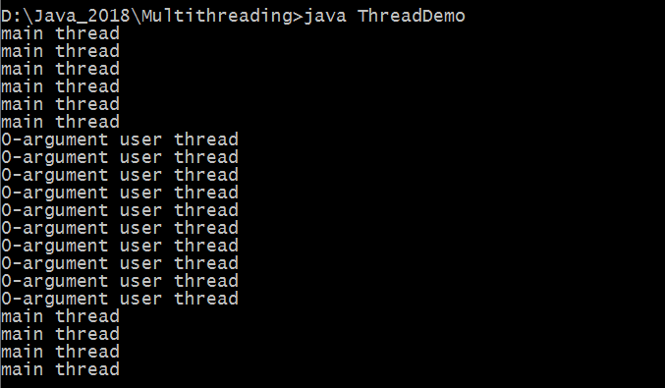
Output-
We can overload run() method but JVM always call 0-argument run() method

Slide 29
How to call overloaded run(int a) method?
public void run()
{
for(int i=0; i<10; i++)
{
System.out.println(“0-argument user thread");
}
run(100);
}

Slide 30
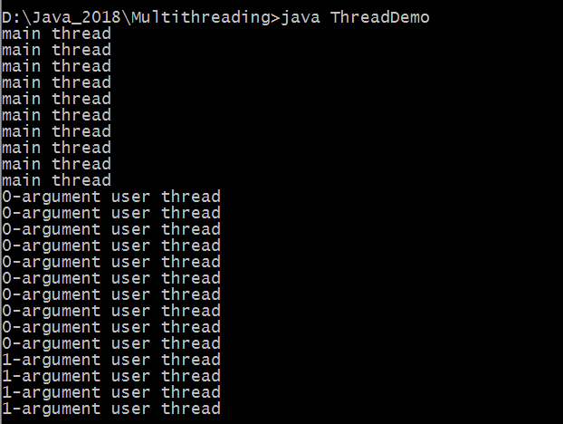
Output-

Slide 31
How to write multiple functionality in run() method?
class MyThread extends Thread
{
public void run()
{ method1();
method2();
method3();
}
void method1(){ S.O.P("method1 called"); }
void method2(){ SO.P("method2 called"); }
void method3(){ S.O.P.("method3 called"); }
}
class RunFunctionDemo
{
public static void main(String[] args)
{
MyThread t = new MyThread();
t.start();
}
}

Slide 32

Output-

Slide 33
Create different thread & different task
class MyThreadOne extends Thread
{
public void run()
{ System.out.println("Thread one"); }
}
class MyThreadTwo extends Thread
{
public void run()
{ System.out.println("Thread two"); }
}
class MyThreadThree extends Thread
{
public void run()
{ System.out.println("Thread three"); }
}
class MultiThreadDemo
{
public static void main(String[] args) {
new MyThreadOne().start();
new MyThreadTwo().start();
new MyThreadThree().start();
}
}
How many thread created here?
4

Slide 34
Thread Methods
setName(String)
getName()
CurrentThread()
getId()
isAlive()
activeCount()
setPriority(int)
getPriority()
setDaemon(boolean)
isDaemon()
join()
join(long)
interrupt()

Slide 35
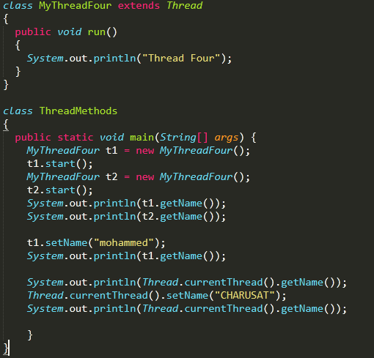
Method Example

Slide 36
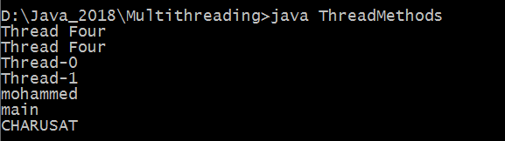
Output-

Slide 37
Daemon Thread
Background thread
Thread which is working on background called daemon thread.
Daemon thread provide support to foreground thread
Low priority thread
Its life depend on user thread

Slide 38
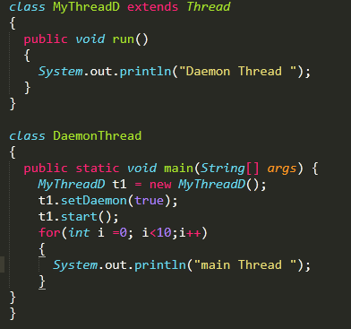
How to make Thread as Daemon Thread?

Slide 39
Few points about daemon thread
Once main thread is completed, daemon thread is terminated whether its completed or not.
main thread never wait, daemon thread

Slide 40
Thread Priority
Each thread have a priority.
Priorities are represented by number b/w 1 and 10.
Thread scheduler will use priority to schedule the threads.
3 constants fields are defined in Thread class:
public static int MIN_PRIORITY --→ default is 1
public static int NORM_PRIORITY --→ default is 5
public static int MAX_PRIORITY --→ default is 10

Slide 41
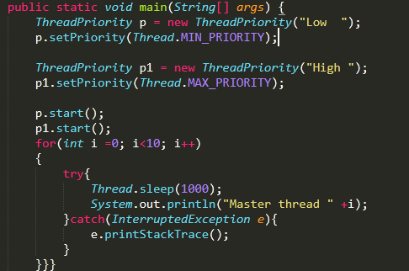
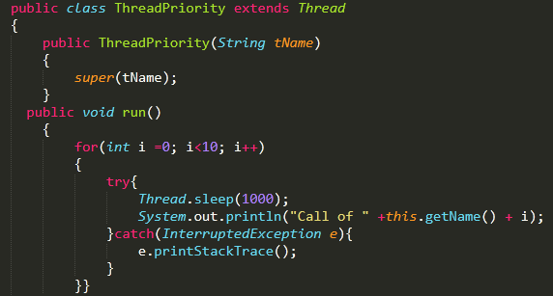
Example

Slide 42
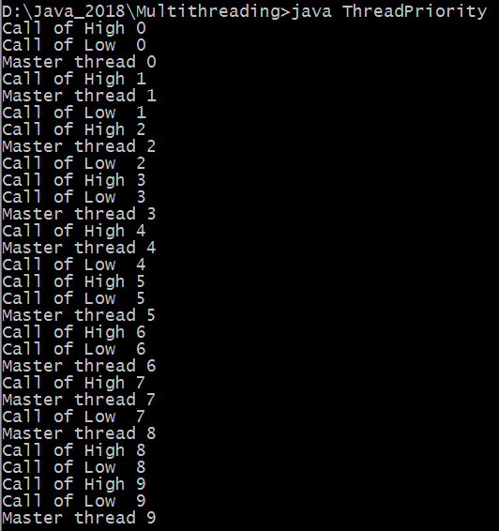
Output

Slide 43
2) By Implementing Runnable Interface
The easiest way to create a thread is to create a class that implements the Runnable interface.
To implement Runnable, a class need to implement only a single method called run().
After implementing Runnable, create an object of class
Call the Thread class constructor Thread(Runnable r, String name)

Slide 44
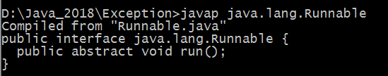
Check Runnable Interface in lang package

Slide 45
Commonly used Constructors of Thread class:
Thread()
Thread(String name)
Thread(Runnable r)
Thread(Runnable r, String name)

Slide 46
Example
class RunnableThread implements Runnable{
public void run(){
System.out.println("thread is running...");
}
public static void main(String args[]){
RunnableThread m1=new RunnableThread();
Thread t1 =new Thread(m1);
t1.start();
}
}

Slide 47
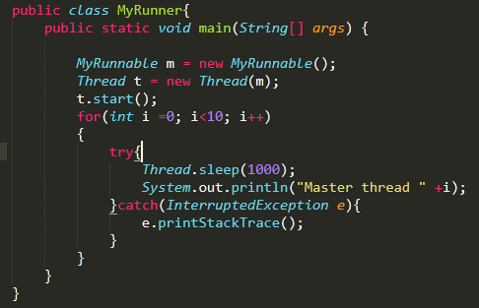
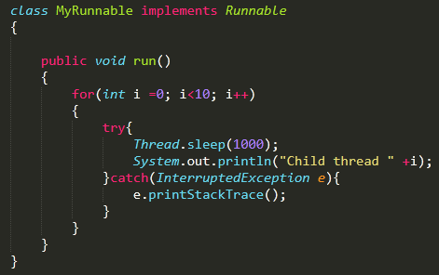
Example-2

Slide 48
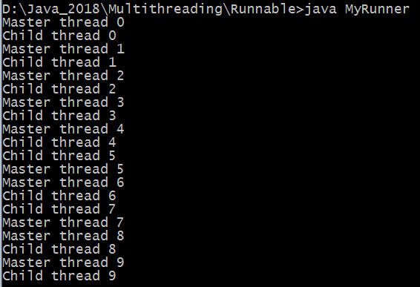
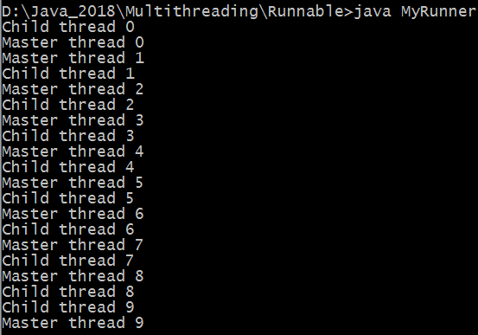
Output

Slide 49
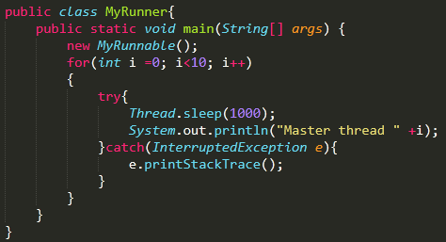
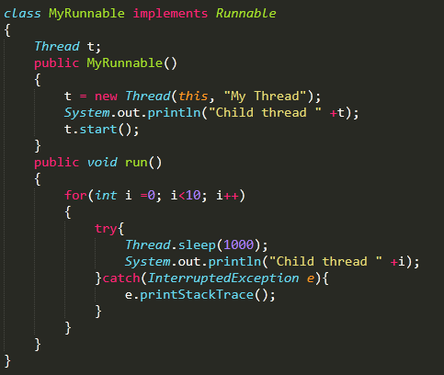
Example-3

Slide 50
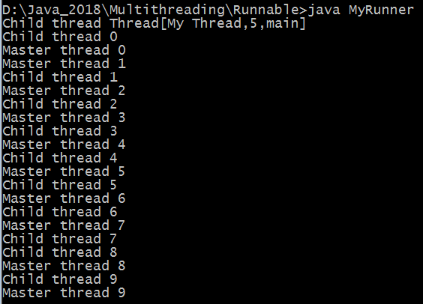
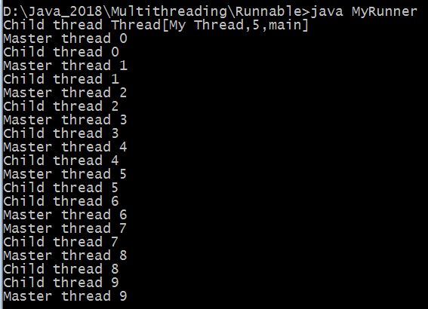
Output-

Slide 51
How to prevent Thread Execution?
Thread offer 3 methods to prevent Thread execution
yield()
join()
sleep()

Slide 52
What is the yield() method?
Let me tell u story – Mobile phone & BSNL landline phone
So yield() method pauses current execution to give the chance for remaining waiting thread of same priority.
If no other thread is waiting or all waiting threads have low priority then same thread can continue its execution.

Slide 53
yield() method in thread life cycle

Slide 54
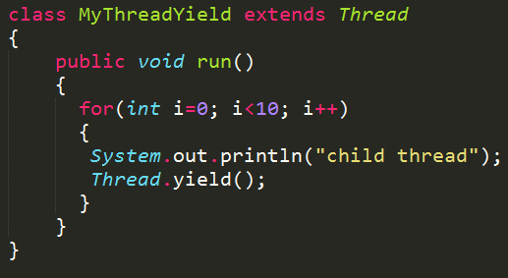
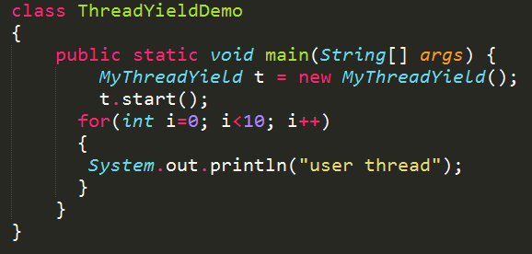
Example

Slide 55
join() method
If a Thread want to wait until the completion of other thread then join() method must call.
t1
t2
t2.join();

Slide 56
3 types of join() methods in Thread class
1. public final void join() throws InterruptedException
2. public final void join(long) throws InterruptedException
3. public final void join(long, int) throws InterruptedException

Slide 57
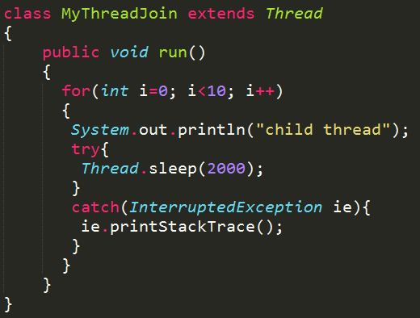
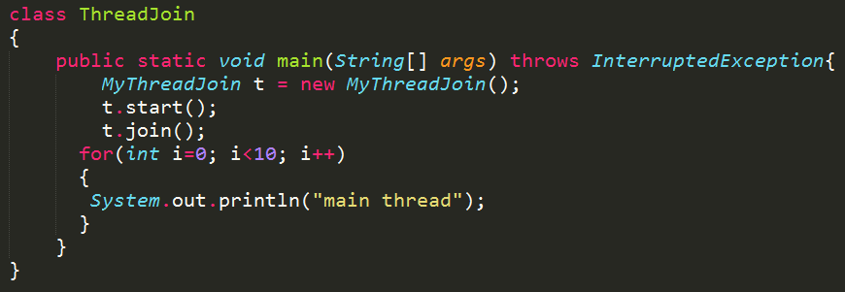
Example

Slide 58
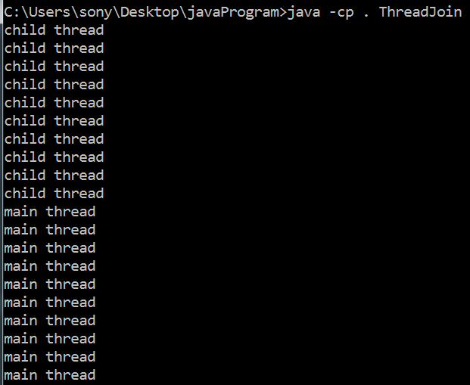
Output

Slide 59
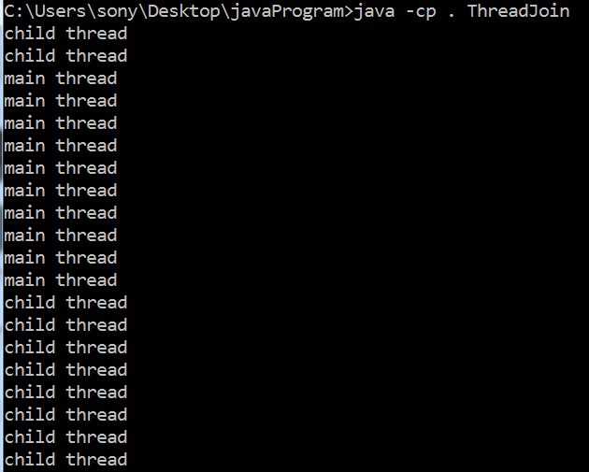
Small change in join() method- t.join(4000);

Slide 60
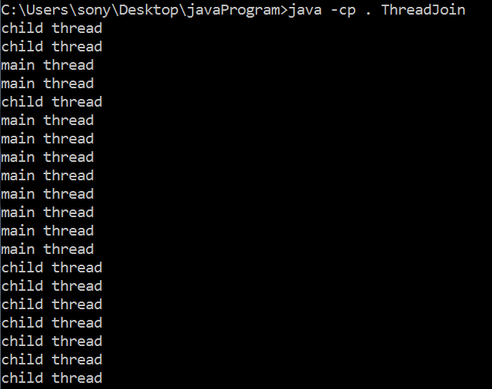
Another Small change in join() method- t.join(4000, 2000);

Slide 61
Most valuable concept in multithreading is Synchronization
People know multithreading but not good in synchronization
Little bit difficult

Slide 62
Few basic point about synchronized modifier
Class can’t be synchronized
Variables can’t be synchronized
Method can be synchronized
Blocks can be synchronized

Slide 63
What is the purpose of synchronization?
For example- if multiple threads try to write within a same file then they may corrupt the data because one of the threads can override data or while one thread is opening the same file at the same time another thread might be closing the same file.
If resources are shared
Railway Tatkal reservation – vary good example
Bank transaction using ATM, Online etc.

Slide 64
Synchronization in Java
Synchronization in java is the capability to control the access of multiple threads to any shared resource.
Java Synchronization is better option where we want to allow only one thread to access the shared resource.
The synchronization is mainly used to
To prevent thread interference.
To prevent data inconsistency problem.

Slide 65
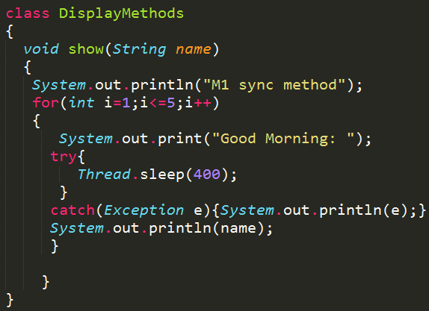
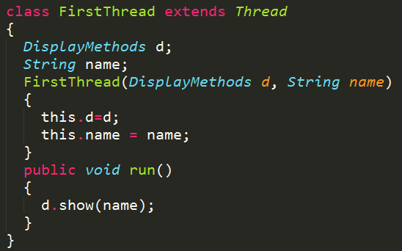
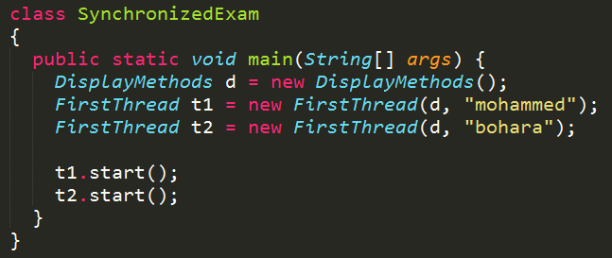
Example

Slide 66
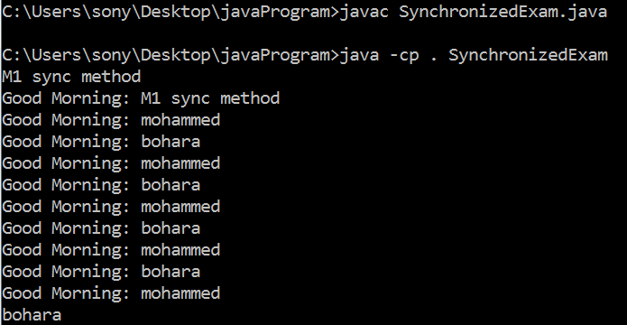
Output
Irregular outcome

Slide 67
Now add synchronized modifier with method
synchronized void show(String name){ }

Slide 68
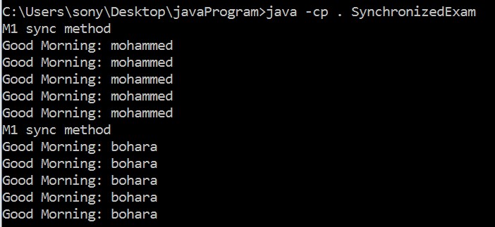
Output
regular outcome

Slide 69
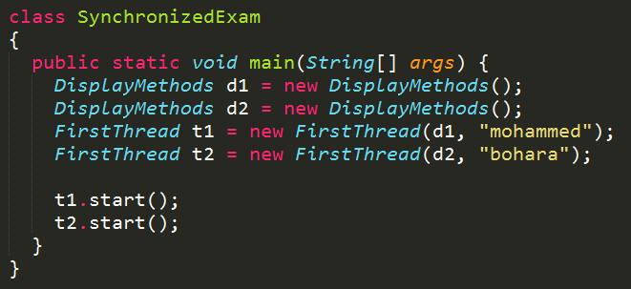
Lets do small modification in previous program
Create two object of DisplayMethod and assign it to different object and check the outcome.

Slide 70
Output
Irregular outcome- even method is synchronized

Slide 71
One solution for such problem
Make method static and synchronized both
synchronized static void show(String name)
Check the outcome again

Slide 72
Output
Called as class level lock
regular outcome- bcs it will make class synchronized

Slide 73
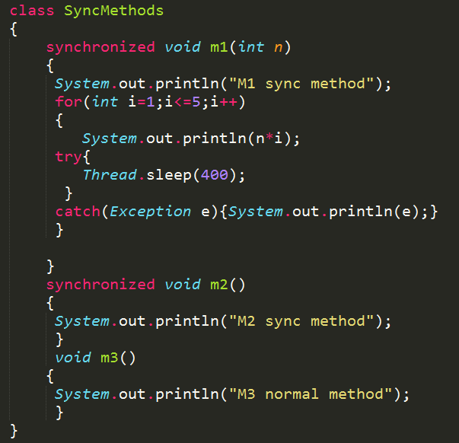
Create two synchronized method and one normal method

Slide 74
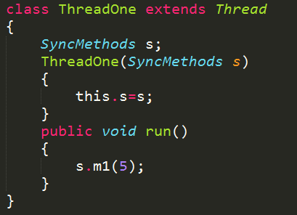
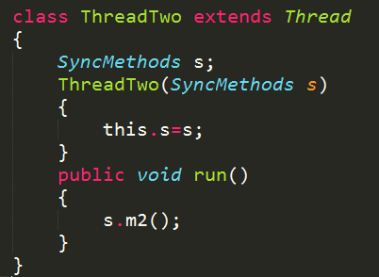
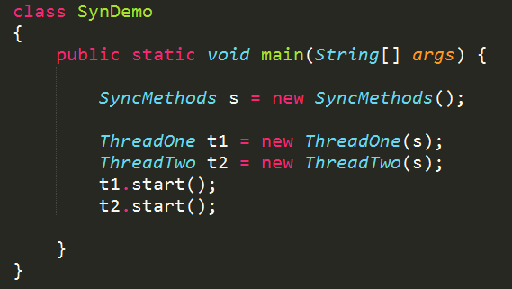
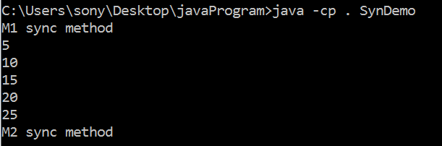

Slide 75
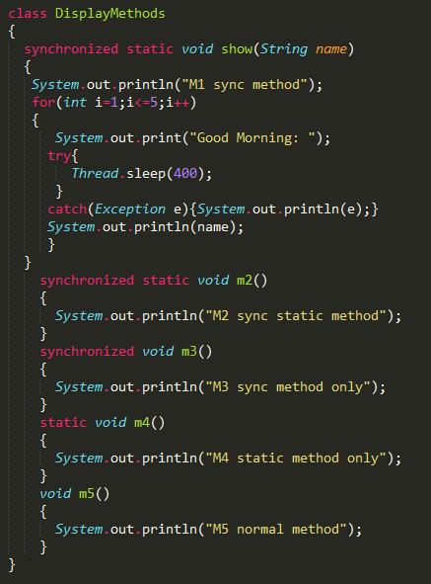
Do one exercise

Slide 76
Is there any problem with synchronized method?
Yes

Slide 77
Synchronized block
Three ways
Get the lock of current object
Get a lock of particular object ‘b’
Get a class level lock ‘DisplayMethods.class’

Slide 78
Get the lock of current object
synchronized(this)
{
}

Slide 79
Get a lock of particular object ‘b’
synchronized(b)
{
}

Slide 80
Get a class level lock ‘DisplayMethods.class’
synchronized(DisplayMethods.class)
{
}

Slide 81
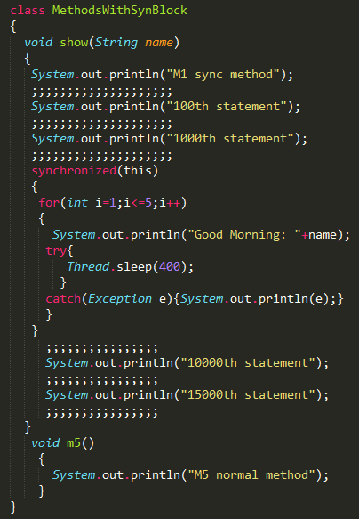
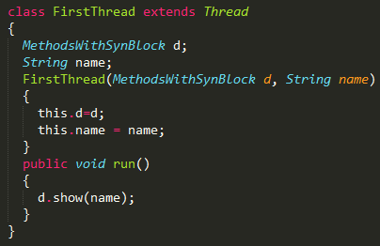
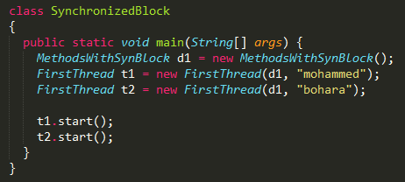
Example

Slide 82
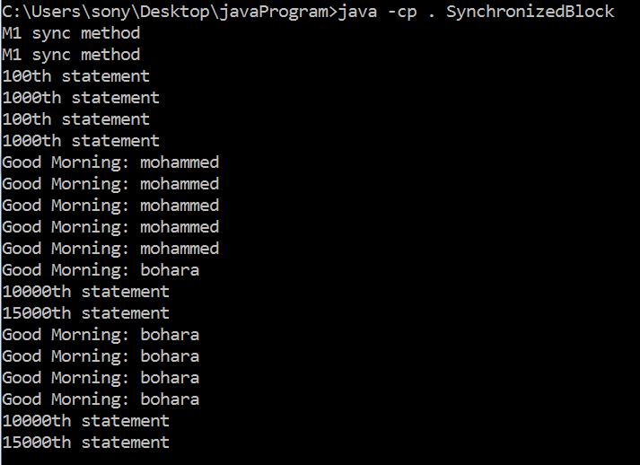
Output

Slide 83
Any Question

Slide 84
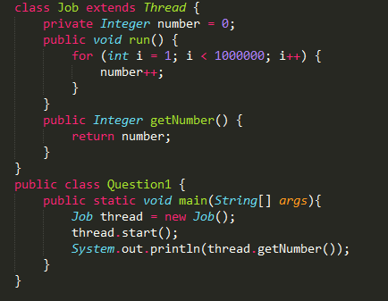
Q-1
What is the output?
A. It prints 0.
B. It prints 999999.
C. The output is not guaranteed to be any of the above.

Slide 85
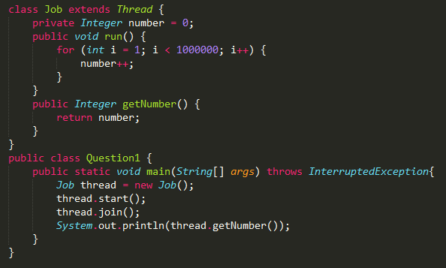
Q-2
What is the output?
A. It prints 0.
B. It prints 999999.
C. The output is not guaranteed to be any of the above.

Slide 86
Q-3 What is the output?
public class Threads3 implements Runnable {
public void run() {
System.out.print("running");
}
public static void main(String[] args) {
Thread t = new Thread(new Threads3());
t.run();
t.run();
t.start();
}
}
A. Compilation fails.
B. An exception is thrown at runtime.
C. The code executes and prints "running".
D. The code executes and prints "runningrunning".
E. The code executes and prints "runningrunningrunning".

Slide 87
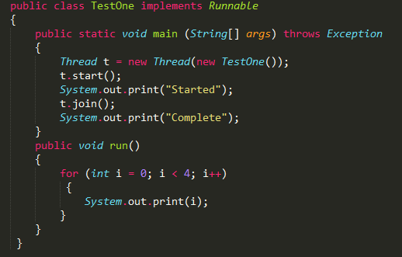
Q-4 What is the output?
A. Compilation fails.
B. An exception is thrown at runtime.
C. The code executes and prints "StartedComplete".
D. The code executes and prints "StartedComplete0123".
E. The code executes and prints "Started0123Complete".

Slide 88
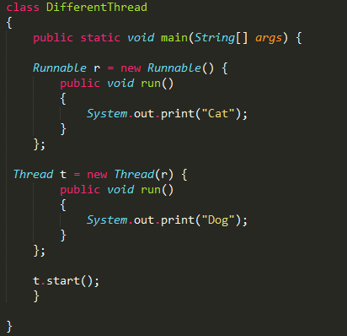
Q-5 What is the output?
A. Cat
B. Dog
C. Compilation fails.
D. The code runs with no output.
E. An exception is thrown at runtime.

